Slide 1

PLANET
PROTECTOR Training
Welcome to the official

Slide 2
Your Training Mission
You must prove you know about sorting garbage, recyclables and compost to be a fully trained Planet Protector.
When this mission is completed, you will earn your Planet Protector I.D.
Good Luck!

Slide 3
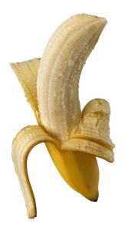
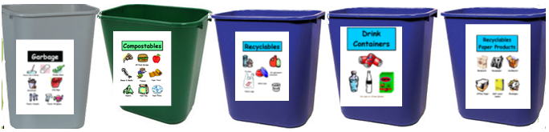
Put Waste in its Place!

Slide 4
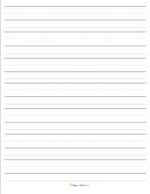
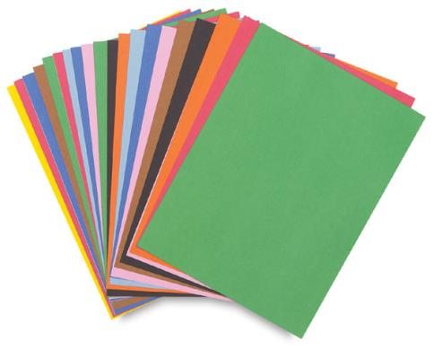
Put Waste in its Place!

Slide 5
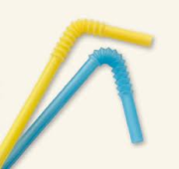
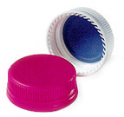
Put Waste in its Place!

Slide 6


Put Waste in its Place!

Slide 7
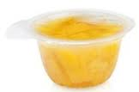
Put Waste in its Place!

Slide 8
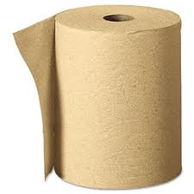
Put Waste in its Place!

Slide 9

Put Waste in its Place!

Slide 10
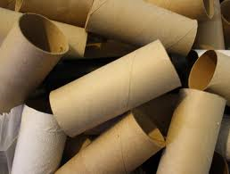
Put Waste in its Place!

Slide 11
Congratulations! You have earned your badge!
www.vwrm.com

